Slide 1


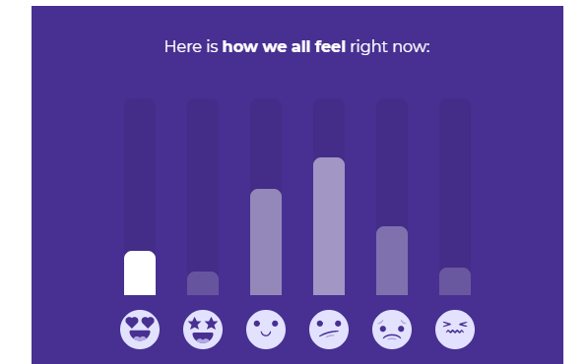

Sample Infographic
How we are all feeling right now
TTC Digital
Survey
1. As you’re trying to conceive, right now you feel…
*Heart eyes emoji*
*Crying emoji*
*Sleeping emoji*
*Happy emoji*

Slide 2
In general, ageing does affect fertility. A woman & man's peak productive period is usually in their 20s.
Sample Infographic
Age
TTC Digital
Survey
20 30 40 50
2. You might want to skip this question, but your age is…
Still young & under 30
30–39 but I’m not worried
40 something & fabulous
Most Fertile!

Slide 3
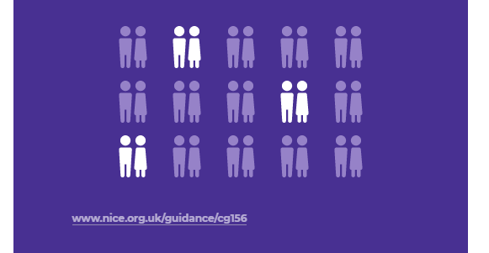
Did you know the number of children born per woman in 2019 was 1.8? A huge decline from 4.9 in 1970.
Sample Infographic
TTC Digital
Survey
3. No pressure or anything but so far, you’ve been trying for…
Just recently started & enjoying it so far
Less than a year
12 months or more
NOTE: Use woman & baby icons instead
Source: Department of Statistics Malaysia

Slide 4
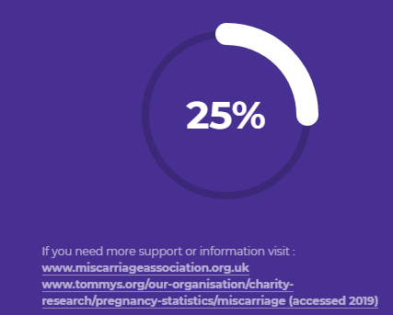
It may be comforting to know that you’re not alone. Miscarriage is possibly more common than you think; affecting affecting up to 20% of pregnant women.
Sample Infographic
TTC Digital
Survey
4. Time to open up! When it comes to miscarriage…
I’ve never experienced it
I had one
I’ve had more than one
Source: Obsterical and Gynaecological Society of Malaysia

Slide 5
A friendly reminder: We understand trying for a baby can be an overwhelming experience, but don’t let it affect your sex life. Try your best to spice things up in the bedroom & just enjoy the ride!
TTC Digital
Survey
5. Don’t be shy now! Making love with your partner when trying to conceive is…
Romantic
Stressful
A workout
A full-time job

Slide 6
Hey, look at what we’ve just discovered: A person’s age, having a career & earning an income is actually one of the highest contributing factors to affect fertility decisions among Malaysian women.
TTC Digital
Survey
6. Let’s be honest: Your main concern so far about trying for a baby is…
My health
My age
My career
My partner
My financial status
Source: http://familyrepository.lppkn.gov.my/713/1/The%20Socioeconomic%20Factors%20in%20Constructing%20Women%20Fertility%20Index.pdf

Slide 7
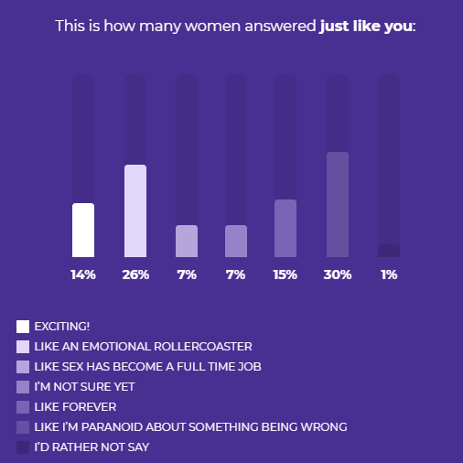
Sample Infographic
This is what some of us have experienced before
TTC Digital
Survey
7. Let’s reminisce! When news of your pre-pregnancy plans first broke out, everyone was…
Loving & supportive
Being judgemental
Asking too many questions
Having too many opinions
Feeling sorry for me

Slide 8
Pssst… here’s a tip: Did you know an ovulation test can maximise your chances of getting pregnant? It’s good to know your most fertile days when you can get pregnant just by using an ovulation test. A great way to help speed things up in the baby-making department!
TTC Digital
Survey
8. Oh boy! So with all the pressure of getting pregnant fast, you’re…
Going with my own flow here
Looking forward to having a lot of sex *naughty emoji*
Going crazy looking at baby bump photos on social media

Slide 9
Sample Infographic
Wow! Here’s how many women manage their emotions just like you
TTC Digital
Survey
9. Tell us your secret! You manage your emotions when trying to get pregnant by…
Exchanging my experience with other mums
Taking a break from baby-making
Not letting my period get me down
Practising relaxation techniques
Limiting going online to find out about pregnancy stuff

Slide 10
Here’s a fact: It has been proven that couples who sought support had improved fertility rates. So, go ahead & seek support when you're trying to get pregnant. We know that it can sometimes seem as if the whole world already has a baby or is expecting one.
TTC Digital
Survey
10. Your biggest “cheerleader” throughout your beautiful baby-making journey is…
My partner
My family
My friends
My colleagues
Kind strangers

Slide 11
Sample Infographic
Look! This is how many women share the same source as you
TTC Digital
Survey
11. Spill the tea! Your no.1 source when planning for your trying-to-conceive journey is…
Seek advice from a gynecologist/fertility specialist
Get tips from other mums
Track using fertility tools (eg. ovulation kit)
Read up on pregnancy tips online

